Slide 1
Differential Privacy
And RAPPOR for privacy in crowdsourced data

Slide 2
What is privacy
Hide the identity of the individual user, yet conduct analytics studies on aggregate user behavior (or provide personalized services)
Just applying anonymization of names etc may not be enough, since one can infer the identity of the user by remaining data
Telemetry data we collect should not be traceable back to the original users. Yet they should be OK to do analysis using that data.

Slide 3
What is privacy
Dalenius’s definition
An attempt at a workable definition of privacy in this setting:
“Anything that can be learned about a respondent from the statistical database should be learnable without access to the database.”
Naturally relates to semantic security in cryptosystems.
“If the release of statistics S makes it possible to determine the value [of private information] more accurately than is possible without access to S, a disclosure has taken place.” [Dalenius]

Slide 4
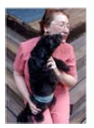
AOL Data Release [NYTimes 2006]
In August 2006, AOL Released search keywords of 650,000 users over a 3-month period.
User IDs are replaced by random numbers.
3 days later, pulled the data from public access.
AOL searcher # 4417749
Thelman Arnold, a 62 year old widow who lives in Liburn GA, has three dogs, frequently searches her friends’ medical ailments.
“landscapers in Lilburn, GA”
queries on last name “Arnold”
“homes sold in shadow lake subdivision Gwinnett County, GA”
“num fingers”
“60 single men”
“dog that urinates on everything”
NYT
Re-identification occurs!

Slide 5
Netflix Movie Rating Data [Narayanan and Shmatikov 2009]
Netflix released anonymized movie rating data for its Netflix challenge
With date and value of movie ratings
Knowing 6-8 approximate movie ratings and dates is able to uniquely identify a record with over 90% probability
Correlating with a set of 50 users from imdb.com yields two records
Netflix cancels second phase of the challenge
Re-identification occurs!

Slide 6
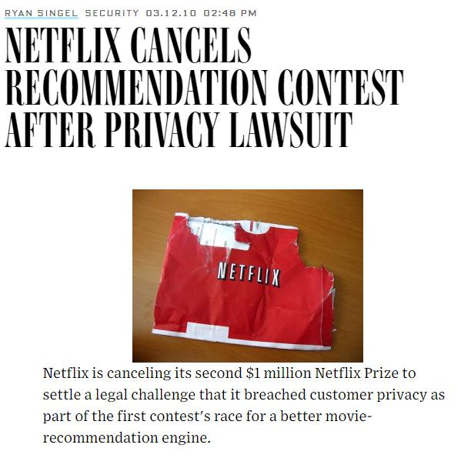
Notes:
同樣是 2006 年，美國最大的影視公司之一 Netflix ，舉辦了一個預測演算法的比賽（ Netflix Prize ），比賽要求在公開資料上推測使用者的電影評分 。 Netflix 把資料中唯一識別使用者的資訊抹去，認為這樣就能保證使用者的隱私。但是在 2007 年來自 The University of Texas at Austin 的兩位研究人員表示通過關聯 Netflix 公開的資料和 IMDb （網際網路電影資料庫）網站上公開的紀錄就能夠識別出匿名後用戶的身份。三年後，在 2010 年， Netflix 最後因為隱私原因宣佈停止這項比賽，並因此受到高額罰款，賠償金額總計九百萬美元。

Slide 7
Why privacy
“Anonymous” datasets have been connected to specific individuals.
AOL search histories.
Massachusetts state employee medical records.
Human genetic datasets.
All of these cases involved auxiliary information.
A technology is required to give incentives (or at least to remove disincentives) to contribute to these datasets.
“First, do no harm.”
If users are not assured their privacy would be respected, they would hesitate to send telemetry data to improve Microsoft services.

Slide 8
How privacy
Suppose we have a dataset of features about individuals
Add noise to the dataset in such a way that the overall dataset characteristics remain unchanged, yet individual persons cannot be identified or inferred from the dataset
For differential privacy, we add Laplacian noise to the dataset

Slide 9
Sanitization approaches
Input perturbation
Add noise to data
Generalize data
Output perturbation
Add noise to summary statistics
Count, sum, max, min
Means, variances
Marginal totals
Model parameters

Slide 10
Differential Privacy
The risk to my privacy should not substantially increase as a result of participating in a statistical database.
With or without including me in the database, my privacy risk should not change much
(In contrast, the Dalenius definition requires that using the database will not increase my privacy risk, including the case that the database does not even include my record).

Slide 11
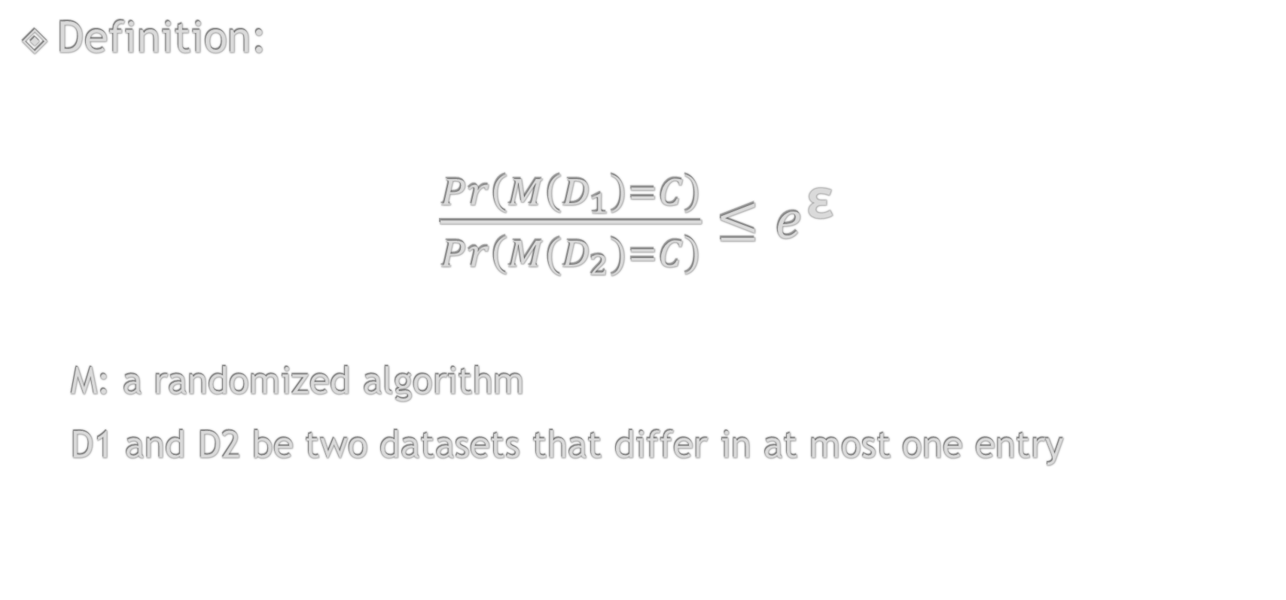
Differential Privacy
Definition:
$\frac{Pr\left(M\left(D_{1}\right)=C\right)}{Pr\left(M(D_{2})=C\right)}≤e^{\text{ε}}$
M: a randomized algorithm
D1 and D2 be two datasets that differ in at most one entry
Notes:
其中 M 是在 D 上做任意查詢操作，對查詢後的結果加入一定的隨機性，也就是給資料加噪音，兩個 datasets 加上同一隨機噪音之後查詢結果為 C 的概率比小於一個特定的數 。這樣就能保證使用者隱私洩露的概率有一個數學的上界。

Slide 12





Example
Name | Age | Preference
X1 | 24 | Laptop
X2 | 23 | Laptop
… | … | …
Xn | 27 | Books
M(D1)
$Pr\left(M\left(D_{1}\right)=C\right)$ = 99%
$\frac{99\%}{98\%}$ = 1.01
$$≤$$
$$e^{\text{ε}}$$
Name | Age | Preference
X1 | 24 | Laptop
X2 | 31 | Laptop
… | … | …
Xn | 27 | Books
M(D2)
$Pr\left(M\left(D_{2}\right)=C\right)$ = 98%
Notes:
上圖中 D1 和 D2 是兩個 neighboring datasets ，他們只有一條記錄不一致，在攻擊者查詢「 20-30 歲之間有多少人偏好購買電子產品」的時候，對於這兩個資料庫得到的查詢結果是 100 的概率分別是 99% 和 98% ，他們的比值小於某個數。如果對於任意的查詢，都能滿足這樣的條件，我們就可以說這種隨機方法是滿足 ε- 差分隱私的。

Slide 13
Differential privacy
It is a mechanism in which the output is unchanged by the presence or absence of a person in the dataset
In constructing a formal approach, we concentrate on pairs of databases (D, D’) differing on only one row, with one a subset of the other and the larger database containing a single additional row.

Slide 14
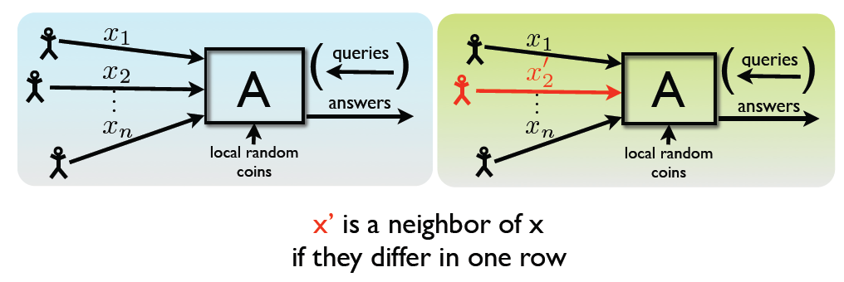
Differential Privacy
For all neighboring databases x and x’
For all subsets of transcripts:
Pr[A(x) є S] ≤ e^{ε} Pr[A(x’) є S]

Slide 15
Differential privacy
An equivalent expression of this idea is given as a ratio bounded by R:
The closer R is to 1, or ε to 0, the more difficult it will be for an attacker to determine an individual’s data.
ε is a publicly known characteristic of the database. It defines the level of privacy maintained and it informs users of the amount of error to expect in the responses it yields.

Slide 16
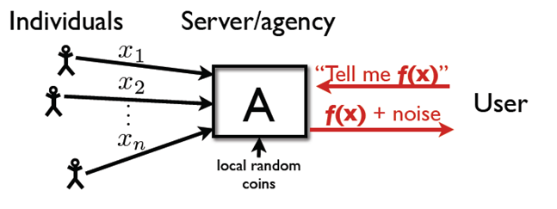
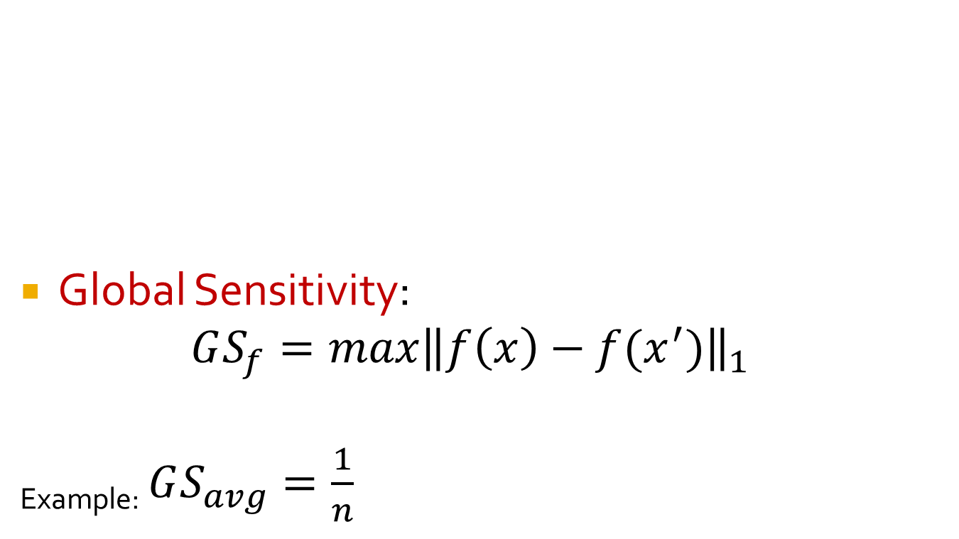
Method: Output Perturbation
x,x’ neighbors

Slide 17
Laplace distribution
We generate noise using the Laplace distribution.
The Laplace distribution, denoted Lap(b), is defined with parameter b and has density function:
Taking b = 1/ε we have immediately that the density is proportional to e^{-ε|z|}.
This distribution has its highest density at 0.
For any z, z’ such that |z - z’|≤ 1, the density at z is at most e^{ε} times the density at z’, satisfying the condition we outlined in the simple case.
The distribution is symmetric about 0.
The distribution flattens as ε decreases. More likely to deviate from the true value.

Slide 18
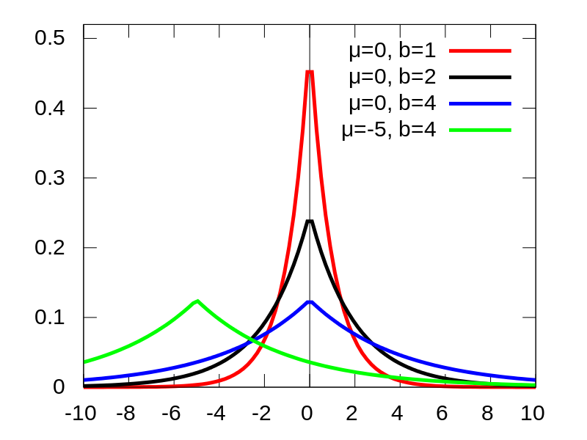
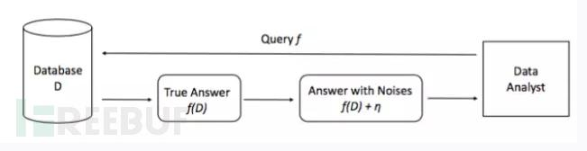
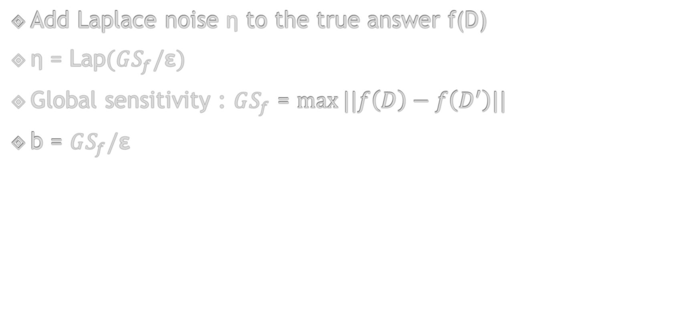
Laplace Mechanism
Add Laplace noise η to the true answer f(D)
η = Lap$(GS_{f}/\text{ε})$
Global sensitivity : $GS_{f}$ = $max⁡||f\left(D\right)−f\left(D^{′}\right)||$
b = $GS_{f}/\text{ε}$

Slide 19
RAPPOR
Privacy preserving scalable system
Used in Anaheim telemetry for crowdsourcing data
Crowdsourcing data to make better, more informed decisions is becoming increasingly commonplace.
For any such crowdsourcing, privacy-preservation mechanisms should be applied to reduce and control the privacy risks introduced by the data collection process.

Slide 20
Randomized Response
A surveying technique developed in the 1960s for collecting statistics on sensitive topics where survey respondents wish to retain confidentiality
An example commonly used to describe this technique involves a question on a sensitive topic, such as “Are you a member of the Communist party?”
For this question, the survey respondent is asked to flip a coin, in secret, and tell the truth if it comes up heads, but lie otherwise (if the coin comes up tails).

Slide 21
Randomized response Example
A coin has a probability p of showing head
Assume proportion of Communist is Pa
Then probability of saying “Yes”:
Py = Pa * p + (1 - p) * (1 - Pa)
Then Pa = (Py + p – 1)/(2p - 1)
Can not get Pa if p equals 0.5 or 1

Slide 22
RAPPOR
Randomized Aggregatable Privacy-Preserving Ordinal Response, or RAPPOR, is a technology for crowdsourcing statistics from end-user client software, anonymously, with strong privacy guarantees.
RAPPORs allow the forest of client data to be studied, without permitting the possibility of looking at individual trees
By applying randomized response in a novel manner, RAPPOR provides the mechanisms for such collection as well as for efficient, high-utility analysis of the collected data.

